Slide 1
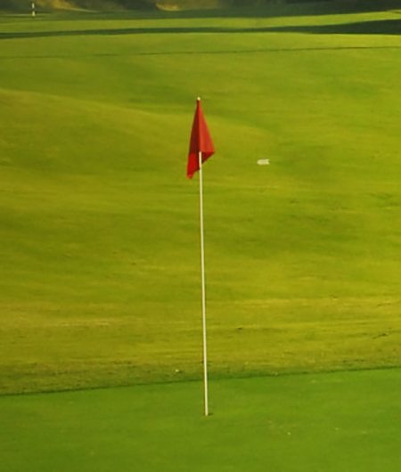


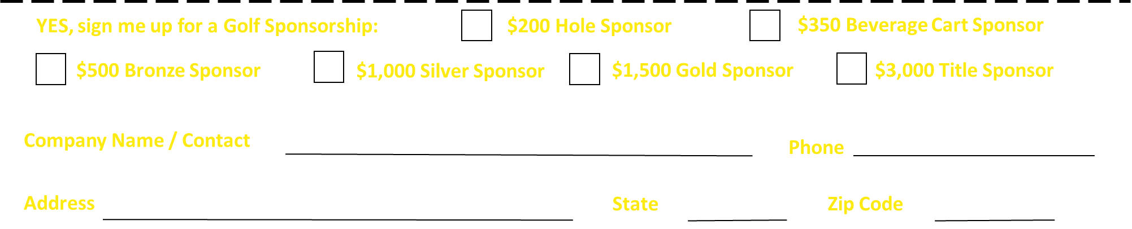
The Addison Hutchison Foundation
1st Annual Golf Tournament
at Larkin Golf Club
Saturday, May 1st • 1pm Shotgun Start
Support The Addison Hutchison Foundation while promoting your company through our numerous tournament sponsorship options.
CONTACT US ABOUT AVAILABLE SPONSORSHIP OPPORTUNTIES
& RESERVE YOUR GOLF HOLE TODAY!
Register online at:
https://app.eventcaddy.com/events/first-annual-addison-hutchison-foundation-golf-tournament
Or fill out and return the form below to:
The Addison Hutchison Foundation
112A Argus Ln Number 146
Mooresville, NC 28117
Email the form: theaddisonhutchisonfoundation@gmail.com
The Addison Hutchison Foundation is a 501(c)3 Non Profit Organization
For more information visit www.theaddisonhutchisonfoundation.org

Slide 2
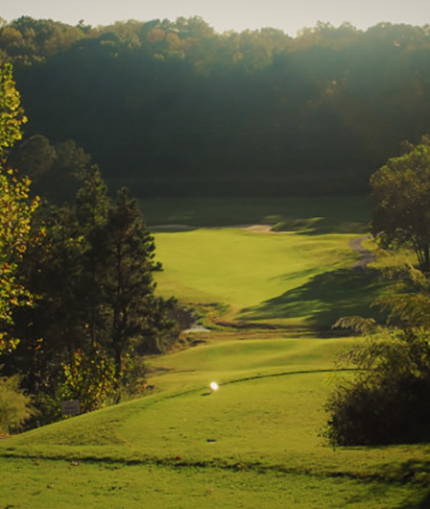
Sponsorship Levels
Hole Sponsor - $200
One (1) golf hole sign (*Option to sponsor 1 of 2 Closest to the Pin Prizes)
Beverage Cart Sponsor - $350 SOLD
Limited to 1 sponsor, recognition on most popular cart on the course, company representative to drive cart and interact with players, company logo included on all marketing materials social media and website
Bronze Sponsor- $500 (7 available)
1 player tournament entry, company logo on all marketing materials, social media and website, recognition as a Bronze Level Sponsor
Silver Sponsor-$1,000 (2 available)
2 player tournament entry, company logo on all marketing materials, social media and website, recognition as a Silver Level Sponsor
Gold Sponsor- $1,500 (3 available)
Team (4 players) tournament entry, company logo on all marketing materials, social media and website, recognition as a Gold Level Sponsor.
Title Sponsor - $3,000 (EXCUSIVE) SOLD
Team (4 players) tournament entry, exclusive naming rights of tournament, banner at the check in table, primary placement on all marketing materials, company representative invited to address players, limited to 1 sponsorship at this level

